Slide 1
The Kruskal Count
Done by: Kareem Moeen

Slide 2
Introduction
A probability based card trick invented by Martin Kruskal.
Analyze failure probabilities of different variants in geometric distribution and uniform distribution, respectively.
Compare the results in different variants with simulation data of the actual Kruskal Count trick.

Slide 3
Objectives
Estimate ensemble success probability by mathematical analysis.
Decide the best strategy to have the highest success odds.

Slide 4
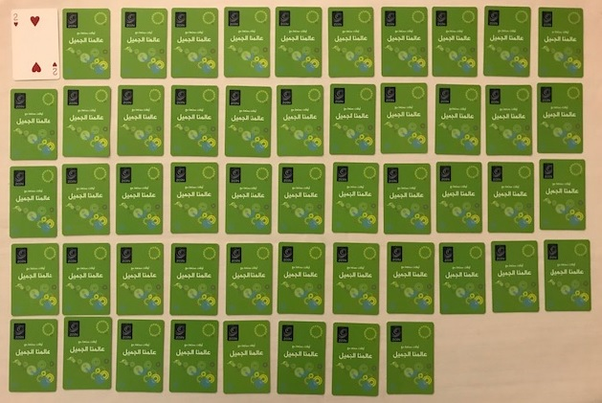
Process of the count
Figure 1.prepare a deck of cards and choose secret number No.1, with the value of card being No.2

Slide 5
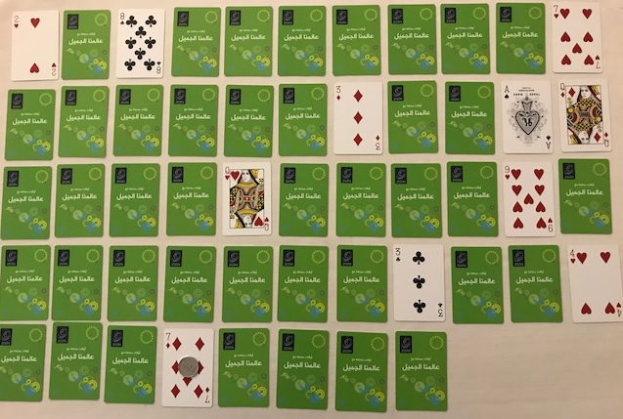
Figure 2. Ended Count with No.7 and we put the coin on it

Slide 6
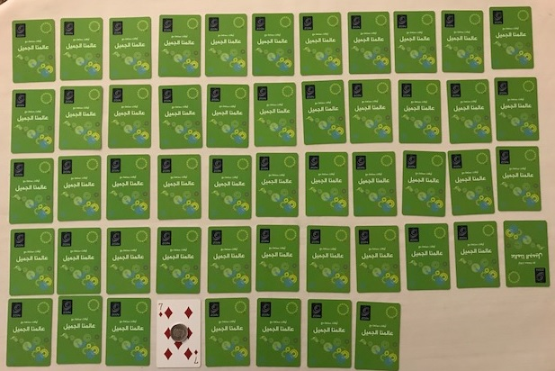
Figure 3.Get the last key card No.7 which is to be “guessed”
by the magician

Slide 7
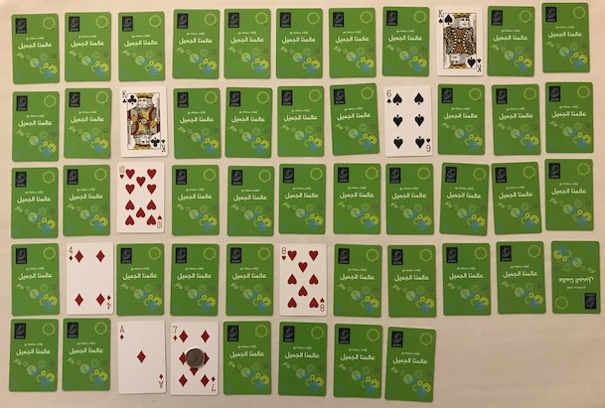
Figure 4. The magician choose secret No.9 and get the same key card No.7.

Slide 8
ESTIMATION
The probability for each card from the first ten cards to be chosen as an initial step can be model as one of following:
Geometric Distribution
Uniform Distribution
Notes:
8

Slide 9
1.Geometric Distribution
(a) Assign the values 11,12,13 to each of J, Q, K.
(b) Assign the value 10 to each of J, Q, K.
(c) Assign the value 5 to each of J, Q, K.

Slide 10
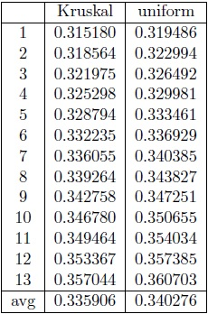
2.Uniform Distribution
Table 1. Failure probabilities for rules variation (a)

Slide 11
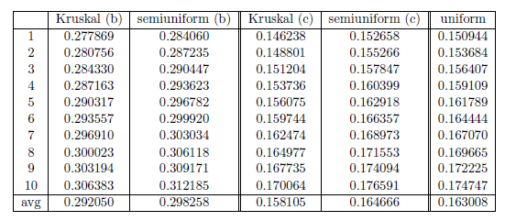
2.Uniform Distribution
Table 2. Failure probabilities for rules variation (b) and (c)

Slide 12
Conclusion
Compare 3 possible rules variations
Face cards taking value 5 rather than 10 or 11, 12, 13 is more successful to the Kruskal Count trick in practice.
Choosing the first card as key card can offer a slightly higher successful probability.
The success probability of the original Kruskal Count trick is just over 85%.

