Slide 1
Traffic Light Model
By Geoff Hale (V00224987) and Chelsea Reid (V00815087)

Slide 2
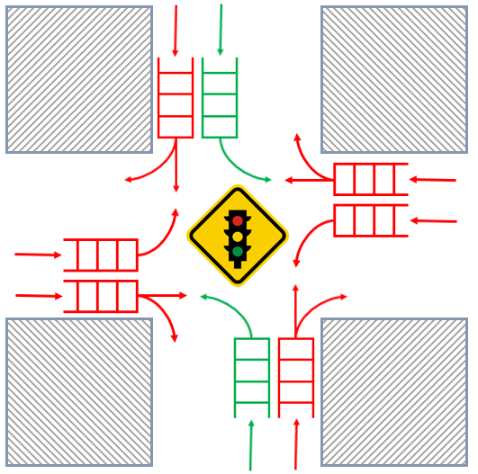
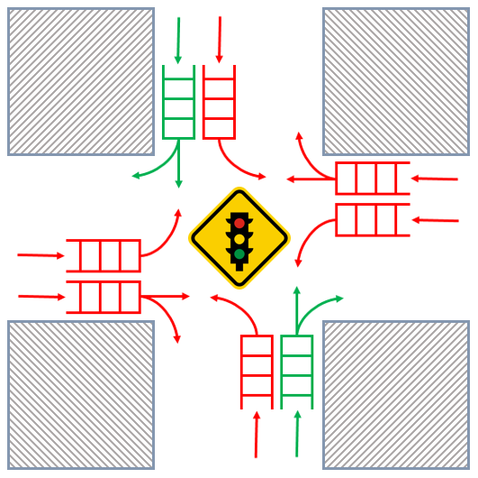
Intersection to Model

Slide 3
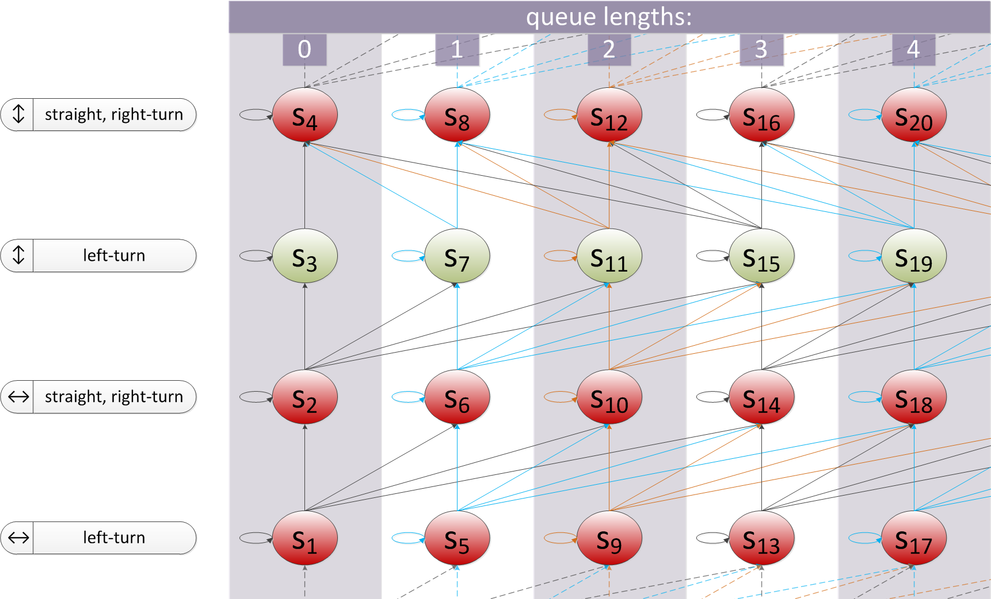
Markov Chain for a Lane
. . .
max of 3 arrivals per time-slot (A=3)
3 departures per time-slot (C=3)

Slide 4
Zoomed in Views
Arrivals Only
Both Arrivals and Departures

Slide 5
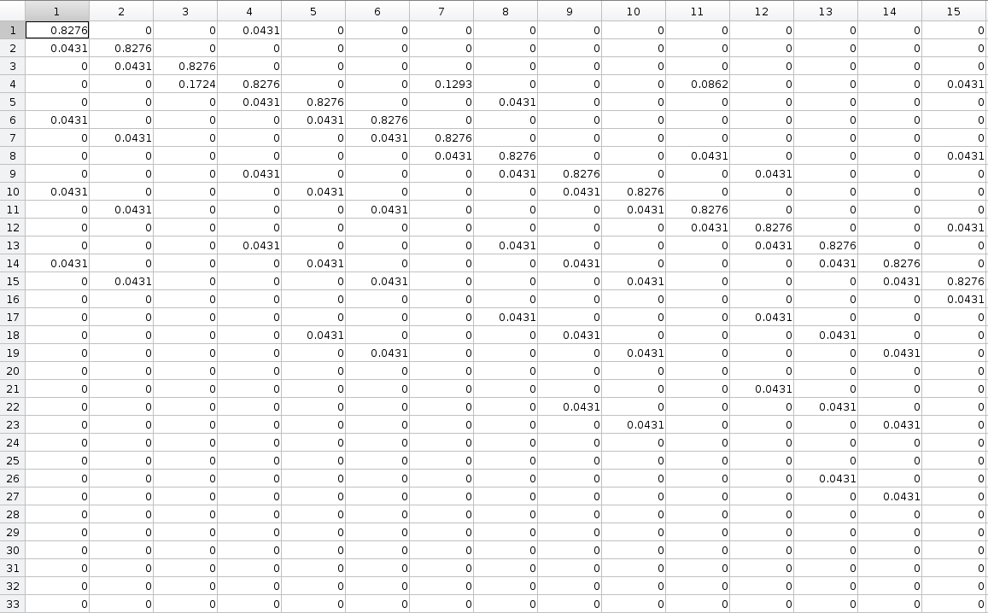
Example of generated P matrix with A=3 and C=3
Part 1
Part 2

Slide 6
Analysis
Average Queue Size = $Q_{a}$ = $\sum_{i=1}^{∞}{\left\lfloor \frac{i−1}{4}\right\rfloor S_{i}}$
Average Output Traffic = $Th$ = $\sum_{i=1}^{M/4}{S_{\left(4i−1\right)}\left(\frac{\sum_{j=0}^{A}{\left(j+\left\lfloor \frac{\left(4i−1\right)−1}{4}\right\rfloor \right)}}{A+1}\right)}$
Where M is the number of rows in the MxM, P matrix
And A is the max number of cars that can arrive per time slot
Average Wait Time = $W$ = $\frac{Q_{a}}{Th}$

Slide 7
Analysis Continued
Average Input Traffic = $N_{a}\left(in\right)$ = $\frac{A}{2}$
Assuming equal probability distribution
Efficiency = $η$ = $\frac{N_{a}(out)}{N_{a}(in)}$ = $\frac{Th}{N_{a}(in)}$
Note: Efficiency is based on the model created for this project and is only an approximation of an idealized intersection. Therefore it should not be used to compare to results of other models.

Slide 10
Things we didn’t Consider
Right hand turns on red lights
Individual car behaviour, such as speed, following distance, etc.
Non-uniform probability distribution for car arrivals
Comparison to other models
Single lane traffic
Comparison to traffic circles

Slide 11
Conclusion

