Slide 1
Component Selection and PCB Fabrication
Supervisor: Dr. Peter Driessen
Presenter: Justin Curran

Slide 2
Notes:
Talk about satellite and team structure

Slide 3
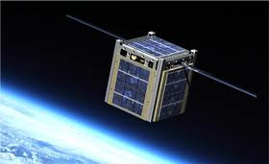
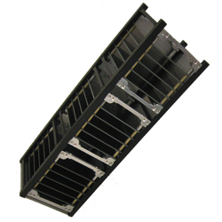
NanoSatellites
Within nanosatellites, there are a set of standard sizes for ‘cubesats’:`
Classification | Size | Weight
1U | 10x10x10 cm | <1.33kg
2U | 10x10x20 cm (two 1Us stacked) | <2.66 kg
3U | 10x10x30 cm This is ECOSat’s Size | < 4 kg
Up to 12U
Notes:
Small form factor
tight packing density
Limited configurations

Slide 4
Problem Description
Whisker growth (heightened probability in vacuum)
Primary concern when using pure Tin, Zinc, Cadmium, or Silver
Growth mechanism not well understood or proven
Notes:
tin alloys, zinc, cadmium, indium, antimony, silver among others
Dendrites are surface growth due to electrochemical migration in the plane of the material

Slide 6
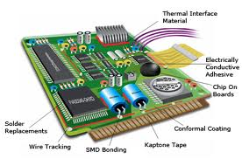
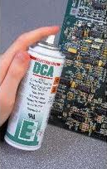
Problem Mitigation
Single solution is not possible since the mechanism is not well understood
Multi prong approach to problem mitigation
Component Selection Criteria
Hot Solder dipping
Silicone Conformal Coating final PCB

Slide 7
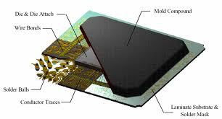
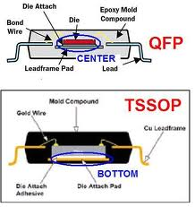
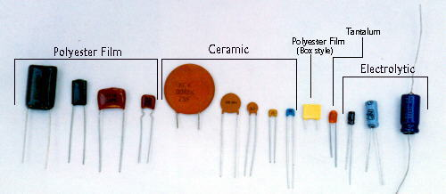
Component Selection
Complex problem many attributes to mitigate and optimize
Plating material
Operating temperature
Package form factor
Material composition
Off gassing Characteristics
Not Limited to IC’s

Slide 8
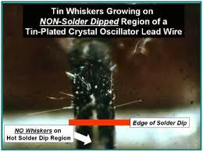
Hot Solder Dipping
Completely resolves Whisker problem
Disadvantages
Time Consuming
Not Available on Campus
Induces thermal shock on ICs
Not all packages can be dipped

Slide 9
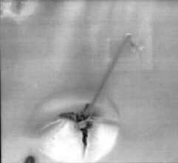
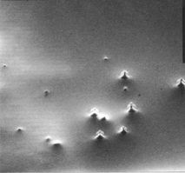
Conformal Coating
Conformal coating is not a guaranteed solution
However it does mitigate the issue and helps impede the growth
Can be performed on campus
Requires little preperation
Performed with minimal equipment

Slide 10
Critical Subsystems
Name | Function | Predicted Hardware
Attitude Determination and Control System | Determine ECOSat’s position, allowing accurate control of orientation | Sun Sensors, GPS, Magnetometers and Magnetorquer Coils
Power Regulation/ Power Generation | Regulate and Distribute power | +7V, +5V, and +3.3V voltage rails, 2 Solar Panels (14 cells)
Battery Charging | Store energy and manage pack charging and connection | 16 Lithium Batteries (4s1p configuration) 2 independent boards with charge controllers
Thermal Monitoring | Maintain temperature within optimal range | Radiators for heat dissipation, Temperature Sensors for monitoring, Duty Cycle used to maintain temperature
Communications | Communicate with Control Station, Facilitate Amateur Radio | 2 Dipole Antennas, 1 Digital board, 2 analog boards for up and down conversion from baseband
Notes:
Unrestricted GPS,
Very sensitive Magnetometers
Power good signal
Power regulator enable

Slide 11
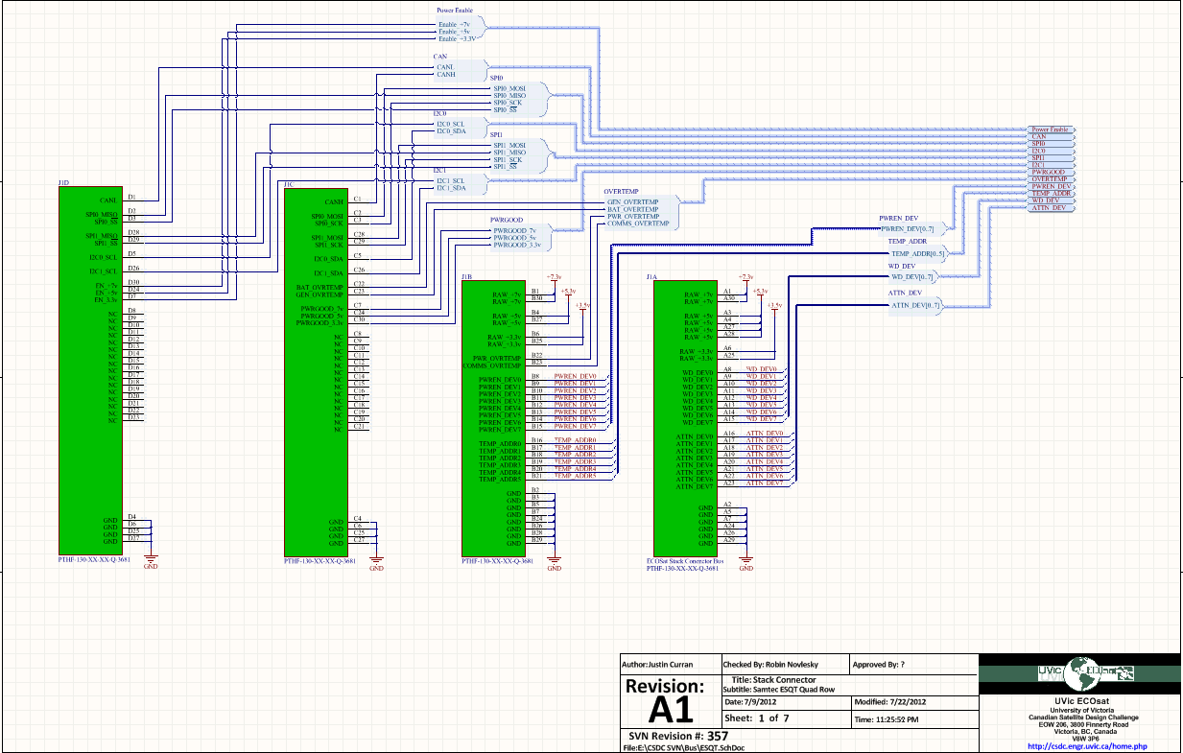
PCB Design and Fabrication
Design complications mitigated through the use of templates

Slide 12
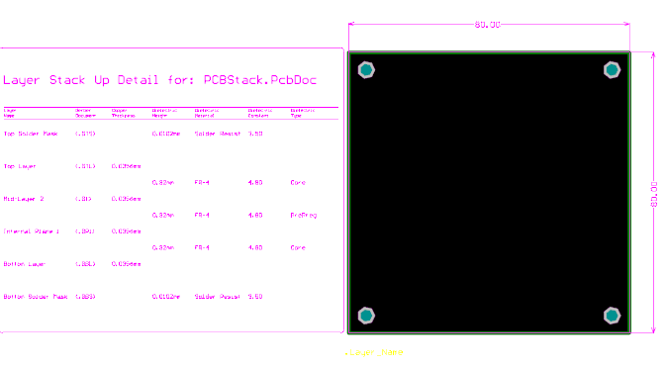
PCB Design and Fabrication
PCB templates to guarantee alignment during final assembly

Slide 13
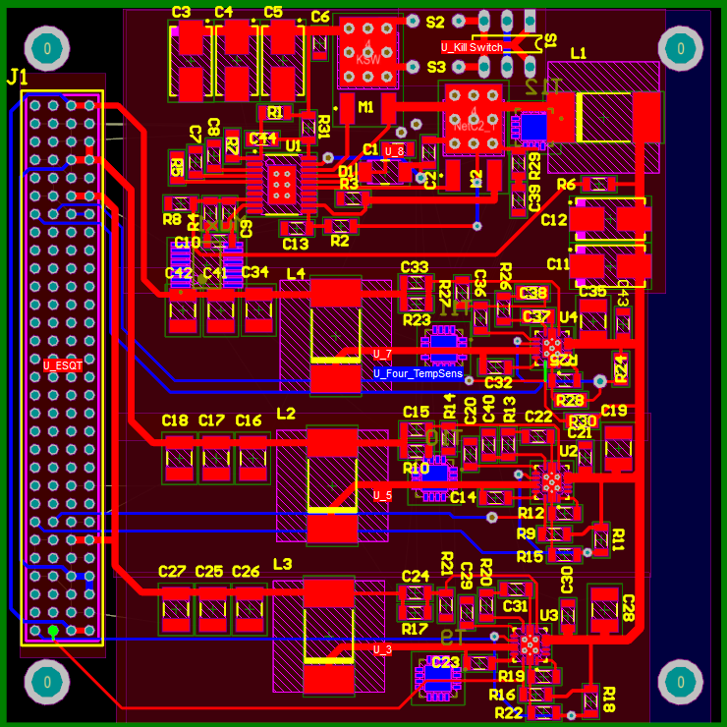
PCB Design and Fabrication
Power Regulation Board

Slide 14
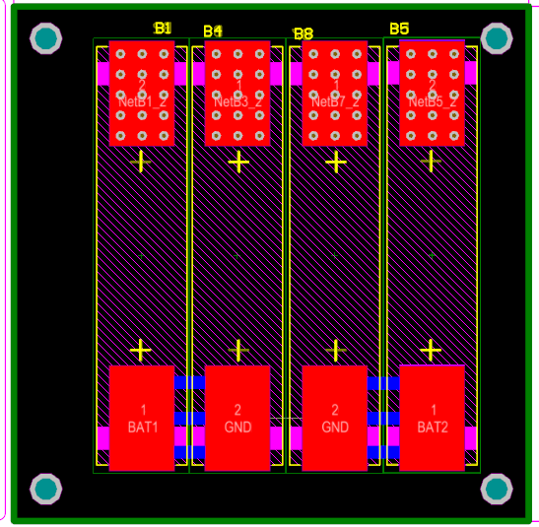
PCB Design and Fabrication
Battery PCB

Slide 15
PCB Design and Fabrication
Boards designs to be completed
Attitude Determination and Control System
With GPS adapter interface
Battery Charging board
Maximum Power Point Tracker
Magnetorquer with drive circuitry
Digital RF Communication Board
Half board for Payload Storage and Communication Interfacing

Slide 16
Special Thanks to our Sponsors

Slide 17
Questions?
Check us out at csdc.engr.uvic.ca
Or email jtcurran@uvic.ca

