Slide 1
UVic ECOSat Analogue Communications System
By Jarrah Bergeron and Kristofor Dolberg

Slide 2
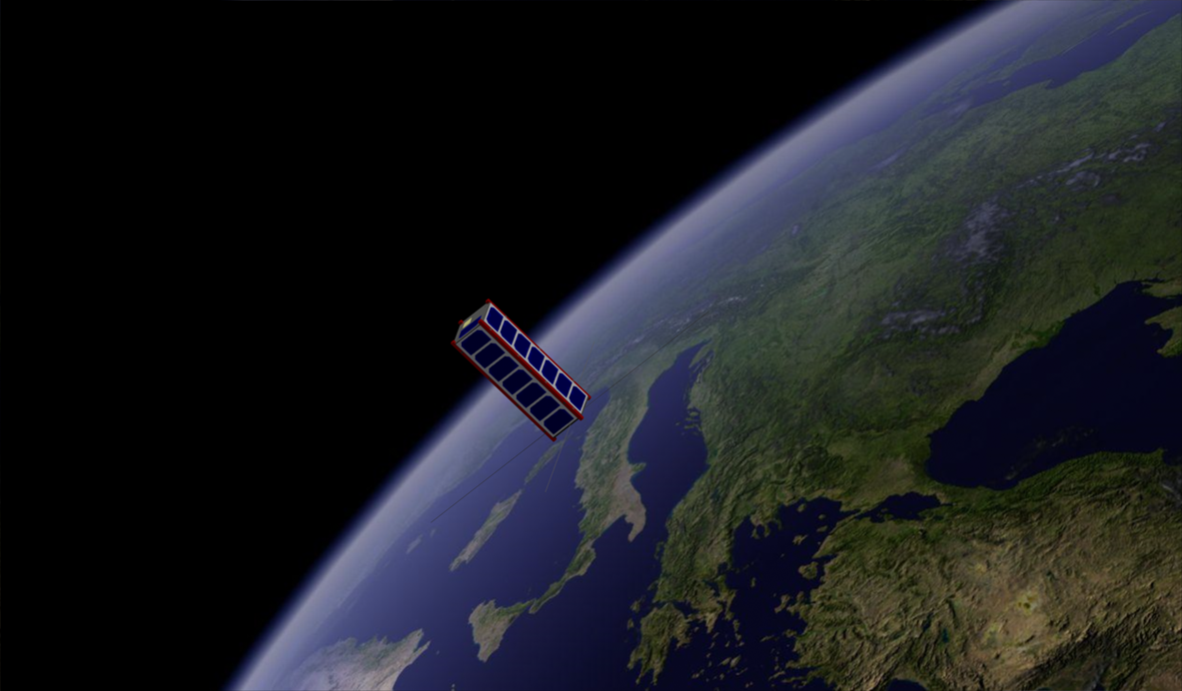
ECOSat

Slide 3
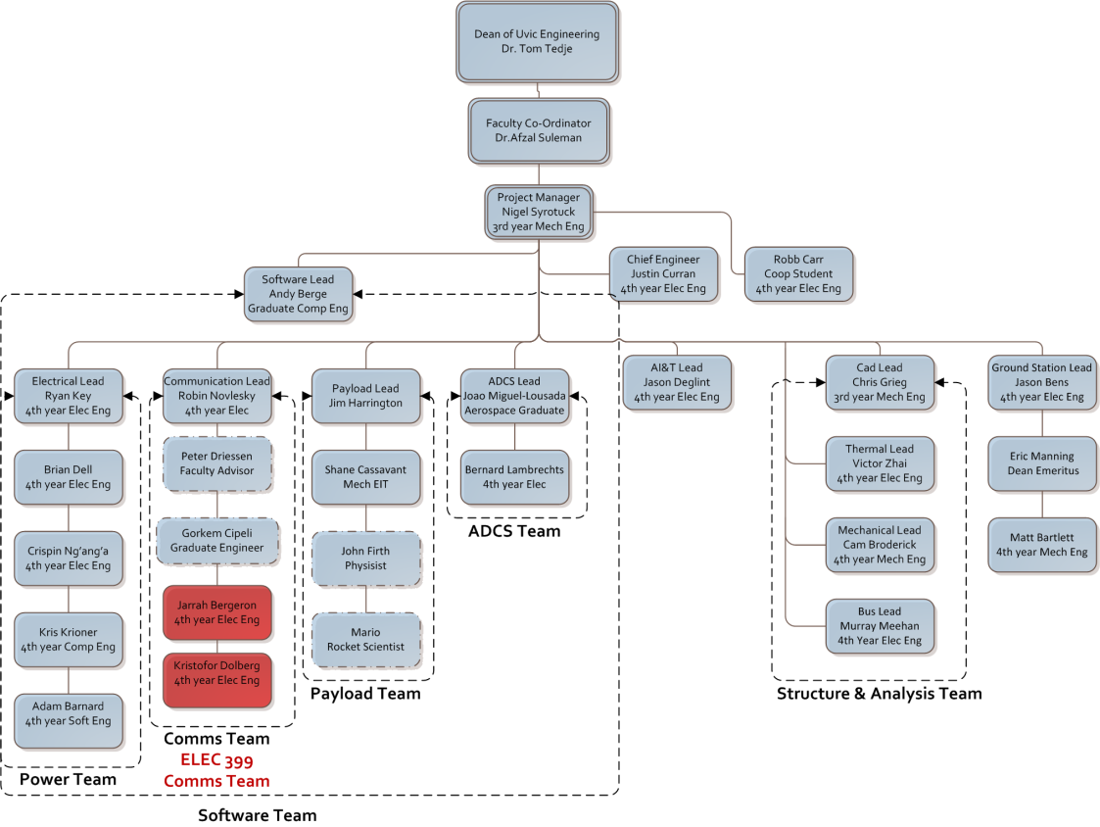
ECOSat Team Structure

Slide 4
Why is the communications system important?
Telemetry: The ECOSat communications system will be used to return the data obtained by the diamagnetic payload to earth.
Amateur radio repeater: ECOSat will be used as a relay satellite for signals broadcasted by amateur radio operators.
Communications research: Some experimental communications platforms designed by Ph.D. student Gorkem Cipli are being implemented on the communications system.
Updates: Comms system may also be used for firmware updates after launch.

Slide 5
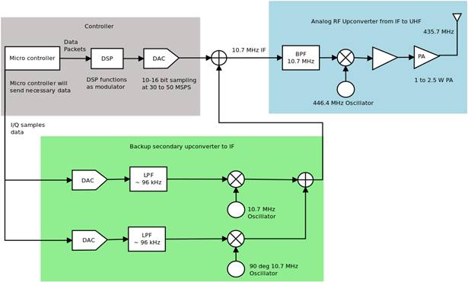
ECOSat Analogue Transmitter

Slide 6
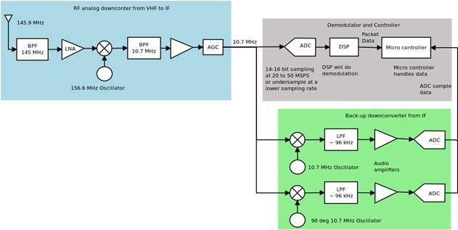
ECOSat Analogue Receiver

Slide 7
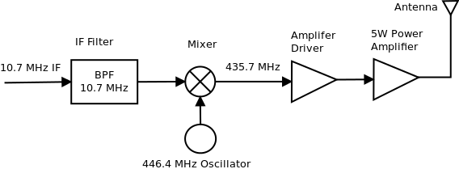
Transmitter Schematic

Slide 8
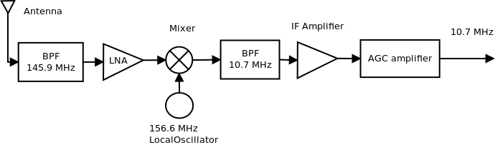
Receiver Schematic

Slide 9
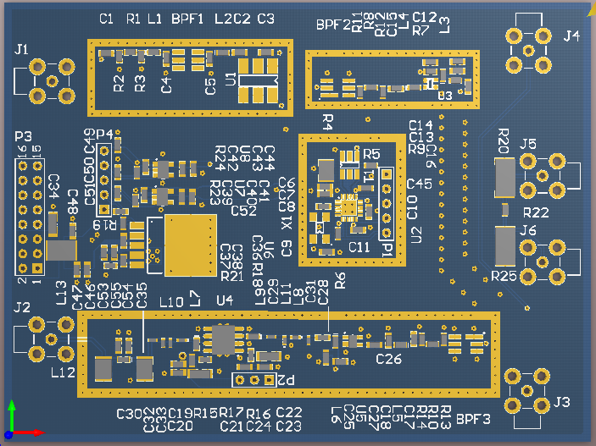
PCB Layout (Transmitter)

Slide 10
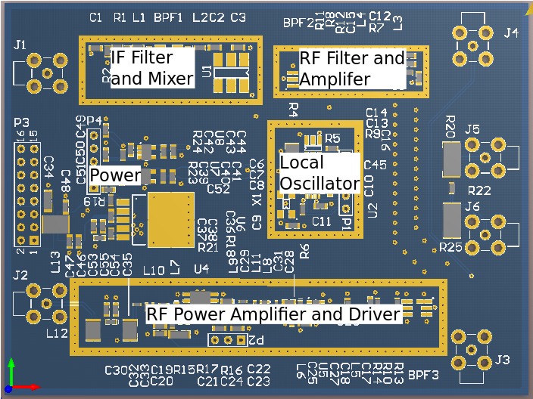
PCB Layout (Transmitter)

Slide 11
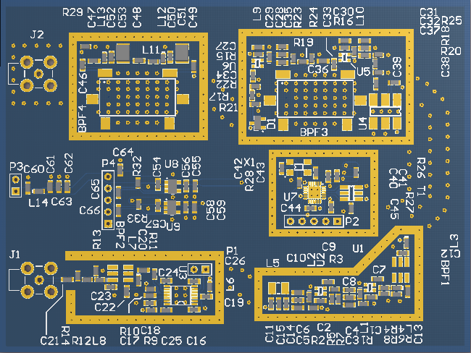
PCB Layout (Receiver)

Slide 12
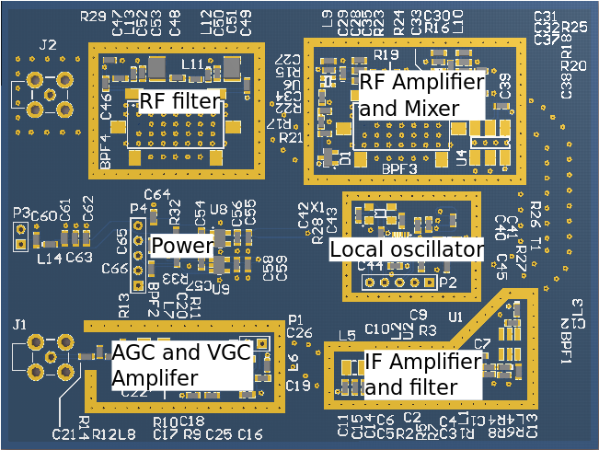
PCB Layout (Receiver)

Slide 13
Acknowledgements
Thanks to Peter Driessen for his assistance and supervisor role for this project.
Dale Reitsma from Daniel’s electronics for lending his extensive expertise.
Geocentrix for making the Canadian Satellite Design Challenge possible.
Anyone who has made even a minor contribution to the ECOSat project.

Slide 14
Questions
??????????????????????????????????????????????????????????????????????????????????????????????????????????????????????????????????????????????????????????????????????????????????????????????????????????????????????????????????????????????????????????????????????????????????????????????????????????????????

