Slide 1
DC-DC Converter for Charging Electric Vehicle Batteries
Elec 399 – Design Project I

Slide 2
Design Project
Supervisor: Ashoka Bhat
Task: To design and build a dc-to-dc converter for charging electric vehicle batteries
Description:
A resonant converter using LCL-type configuration.
Couple to the vehicle using a clamping type high-frequency transformer.

Slide 3
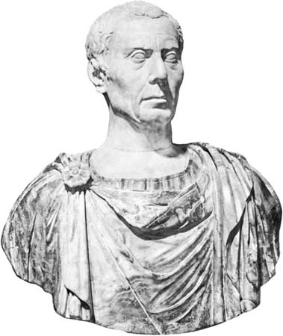
Workload Distribution
Management | Research and Design | Conceptual and Theoretical Study
Neil Hindle | Allen Houle Brayden MacDonald Nathan Bellmore | Jason Small
“Divide and conquer”
-- Julius Caesar

Slide 4
Design Goals
Safety
  Eliminating exposed conductors
  Automatic disconnect in the event of unexpected tension on the charging connection
Efficient and reliable power transfer
  Reduce losses
  Improve voltage control
  Intuitive design for automatic shut off

Slide 5
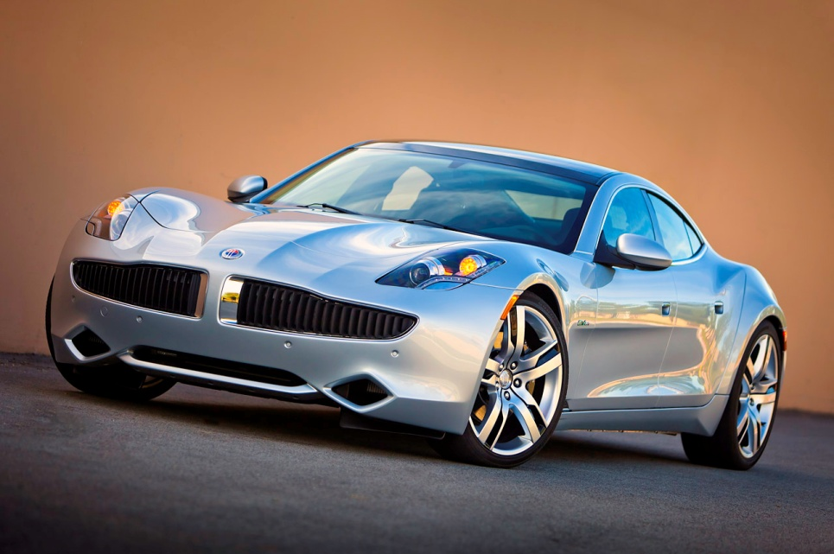
Industry Potential and Requirements
Commercial Potential
  Shift towards green technologies due to:
    Overconsumption of fossil fuels
    Environmental concerns
  Forecasted increase in electric vehicle purchasing
Industry Requirements
  Standardized receptacles and battery/circuitry layout

Slide 6
Supply
Standard household supply
  220VAC
Prototype would require scaling to be feasible.
  1:10 scale selected
  30VDC input
  15VDC output

Slide 7
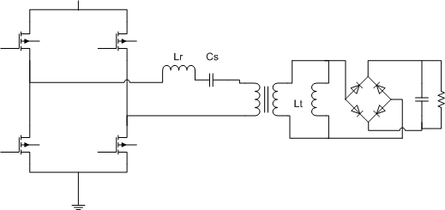
System Overview
Converter
Rectifier
Switching Circuit

Slide 8
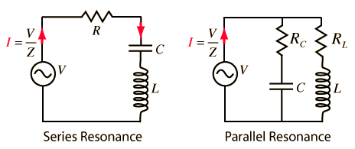
Converter Selection
Series resonance
  Voltage regulation issues at light loads
Parallel resonance
  Lower efficiencies at light loads
LCL –type series resonance
  Inductor added in parallel to primary or secondary of transformer
  Overcomes many issues faced by conventional converters

Slide 9
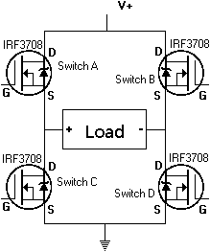
Switching Circuit
H-bridge mosfet inverter
  Converts DC input to square wave AC for use in the LCL-type series resonant converter.
  Turn-off losses dictate the use of switches with fast turn-off times
  Gating signal will be developed
  by an Arduino Microcontroller

Slide 10
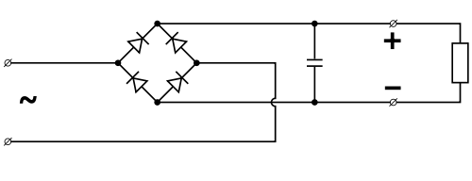
Rectifier Circuit
Diode bridge with smoothing capacitor
  Converts AC from transformer back to DC for use charging batteries
  Full bridge allows the use of both positive and negative halves of input
  Capacitor reduces ripples in input voltage

Slide 11
Control Circuit
Arduino Mircocontroller
  Low-cost
  Accessible development platform
Used to control switching frequency to attenuate charger output
  PWM pins to be investigated further

Slide 12
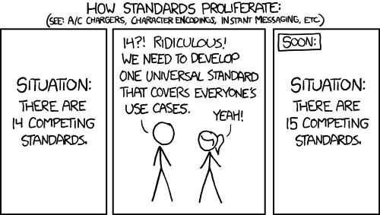
Thanks for listening

